Slide 1

Notes:
Hi Everyone,
Good Morning
Before we start with the presentation today, I would like to share a small recital.
We have been a part of Publicis Sapient for almost 3months now, and there is this fact that everyone of us would agree upon.
We all started as fresh graduates, underwent 5weeks or so of rigorous training followed by what…5 weeks now of a Hands On project, and what has transpired in these days is a fact that we all are really proud of. A transformation from someone who could code, to someone who can not only code, but add value to everything he does.
So have we succeeded at becoming a Product engineer?
Hi, I am Rajat, a small part of our big team here.
I am here with my colleagues Aman and Chinmay and we are here to give you a walkthrough of our Transformation, our Journey and the project we have been working for sometime now.

Slide 2
JEDI-7 Group-5
Day 0 – Where we started?

Slide 3
Framework for 2 Weeks
2 weeks plan
EveryDay Discussion about topics / Technologies / doubt clearance .
EveryDay with SME/ Trainer discussion of Project progress and transformation based on UML and Technologies

Slide 4
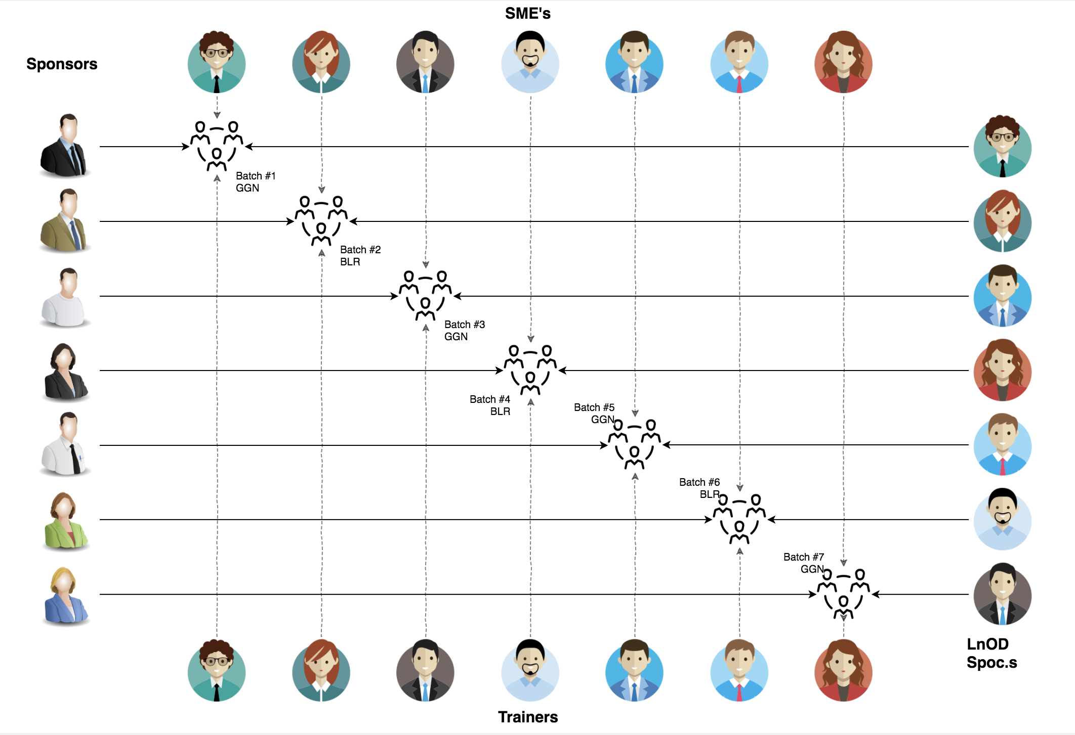
Stakeholders
Sponsors
Flipkart
2 SME
Amit Balyan
3 Coordinators
1. Deepika Gajraj
2. Khushboo(Order trainings)

Slide 5
2 WEEKS OF TRAINING + PROJECT DEMO
12 DAYS
96 HOURS
5,760 MINUTES
3,45,600 SECONDS
LIMITLESS KNOWLEDGE

Slide 6

Agenda
01
Our Journey
02
Our Team
03
Team Structure
04
Project Goals
05
Engineering Practices
06
Tech Stack
07
Development
08
Challenges & Learnings
09
Demo
10
Questions
Notes:
Time – 1 min

Slide 7

Our Journey
Notes:
Time - 2 mins

Slide 8
Demo
Mindset
Process
5
project Demo
Tools
4
Adapting to a developer
Mindset
Comprehend
3
Design Thinking
2
Decide the Technologies JAVA/REST
1
Understanding Project Goals

Slide 9

Our Team
Notes:
Time – 2 mins

Slide 10
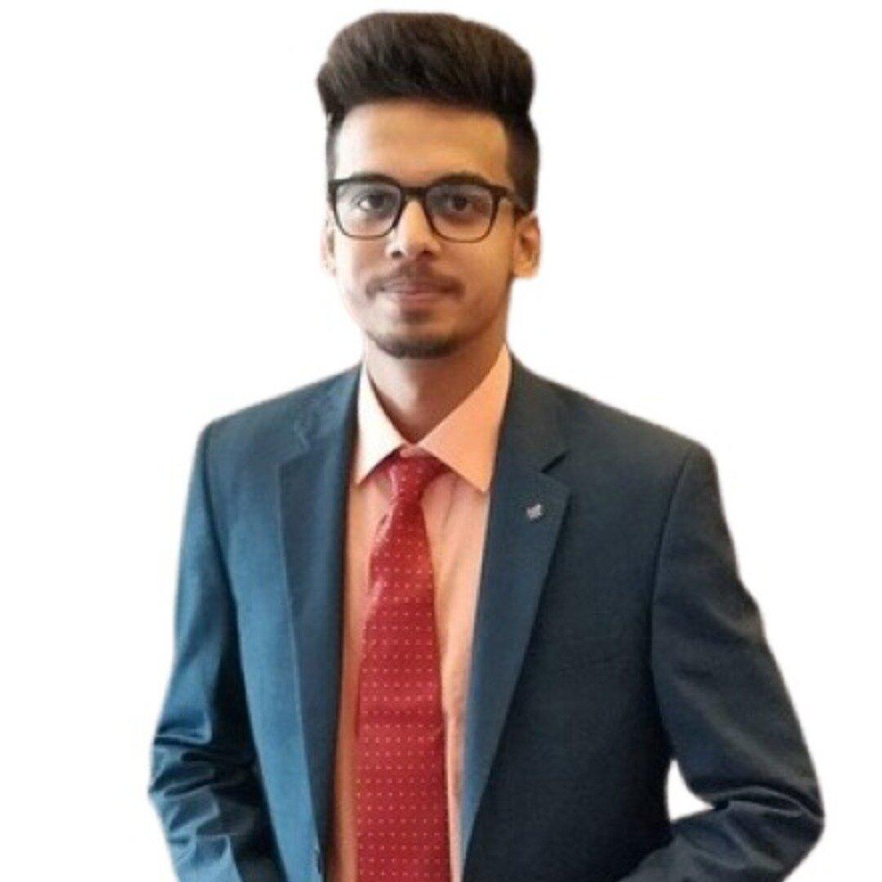
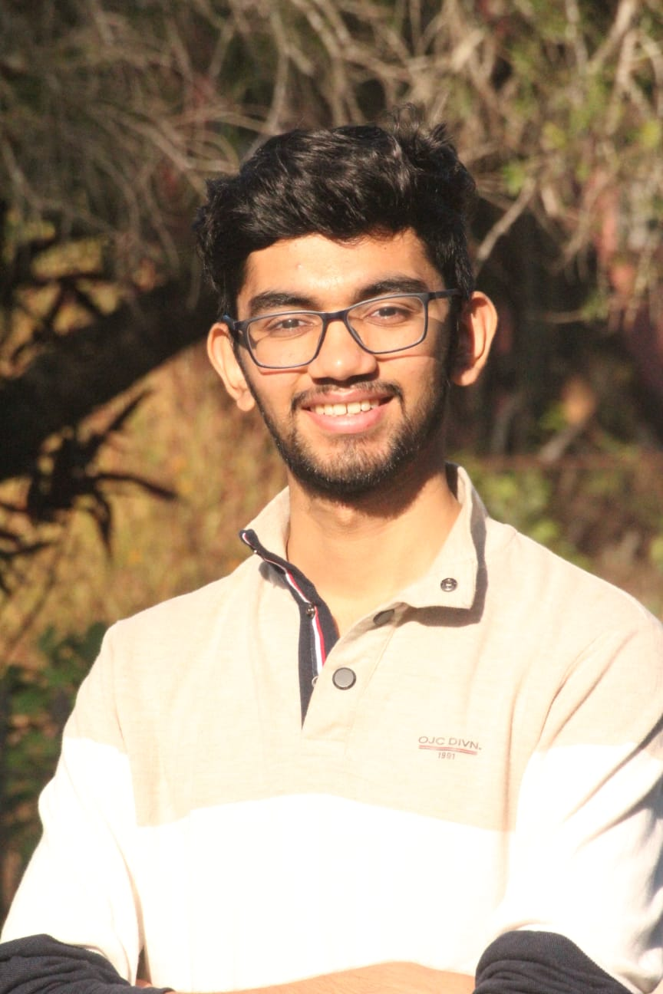
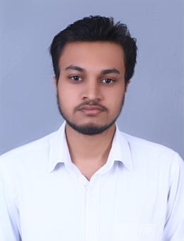
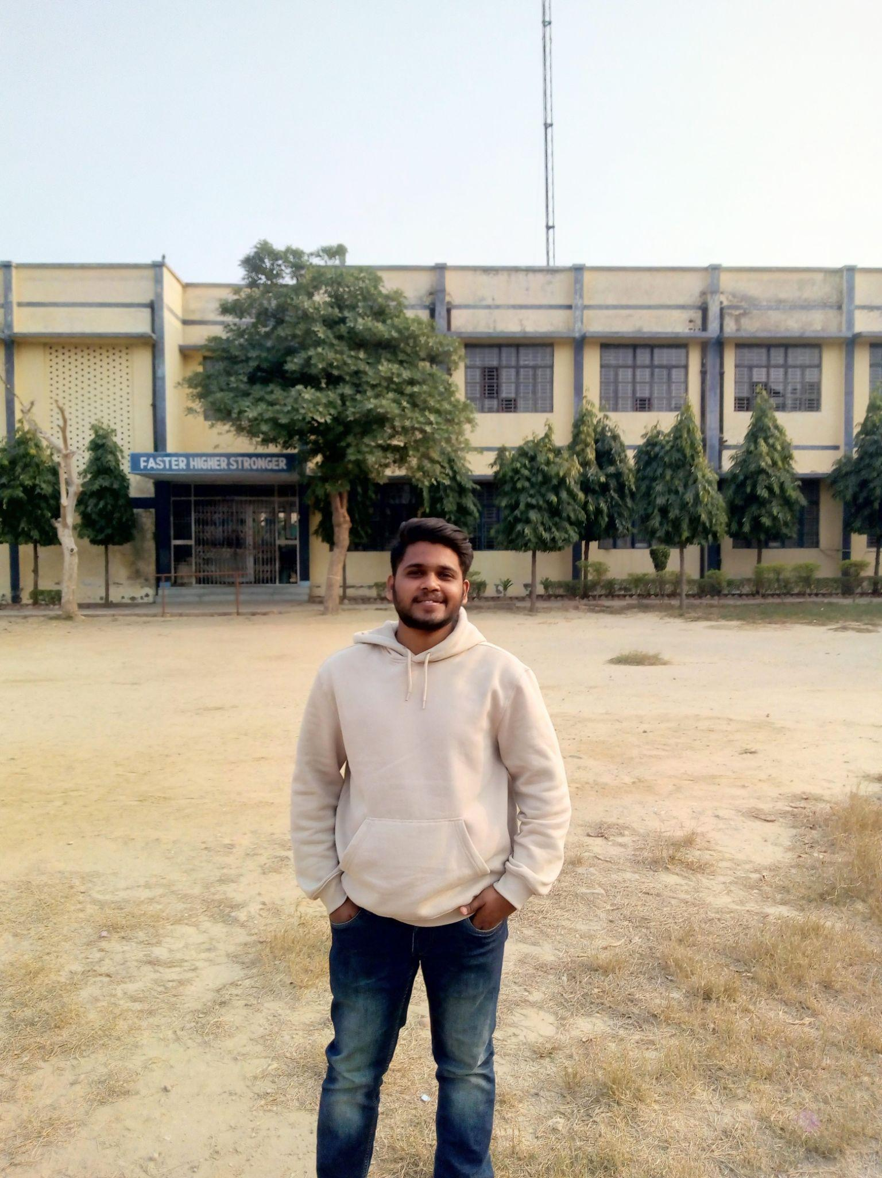
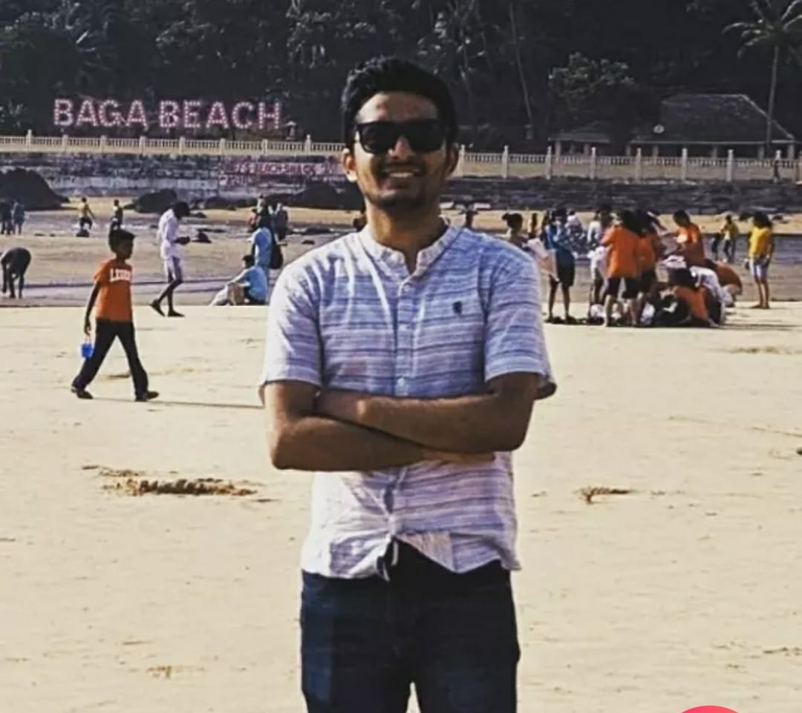
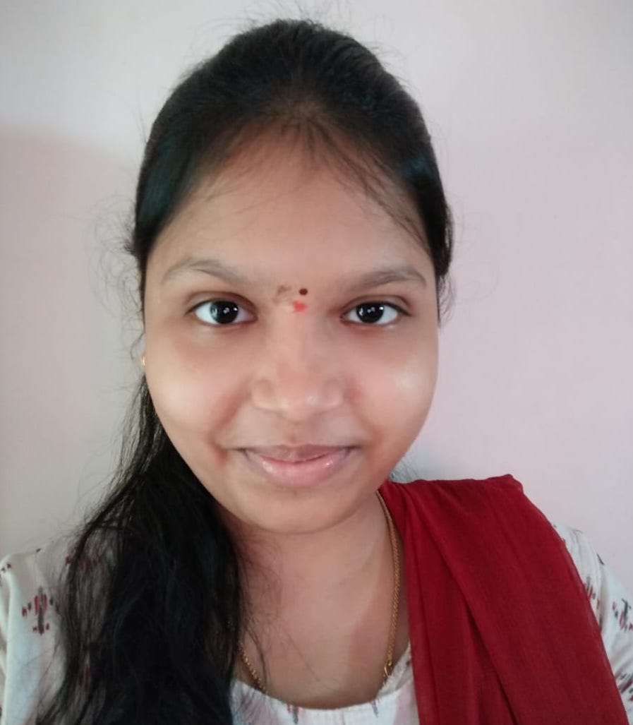
Amit Tiwary
Kartikeya M
Ashutosh Gupta
Vineet Sharma
Vedang
Dakshayani K

Slide 11

Team Structure
Amit - Git , REST
Ashutosh - UML, POS Dakshayani - UML, PPT
Kartikeya - POS, Dropwizard
Vedang - REST, POS
Vineet - Dropwizard, PPT
Notes:
Time – 2 mins

Slide 12

Project Goals
To create a Course Registration System using JAVA/REST tools and technologies, where a professor as well as a student can view courses and enroll in some of the courses and other things as mentioned in the problem statement.
Notes:
Time – 3 mins

Slide 13




Our Vision
1
2
Quality
Security
3
4
Interactivity
Speed
Notes:
User satisfaction and brand value

Slide 14

Engineering Practices
Notes:
Time – 5 mins

Slide 15
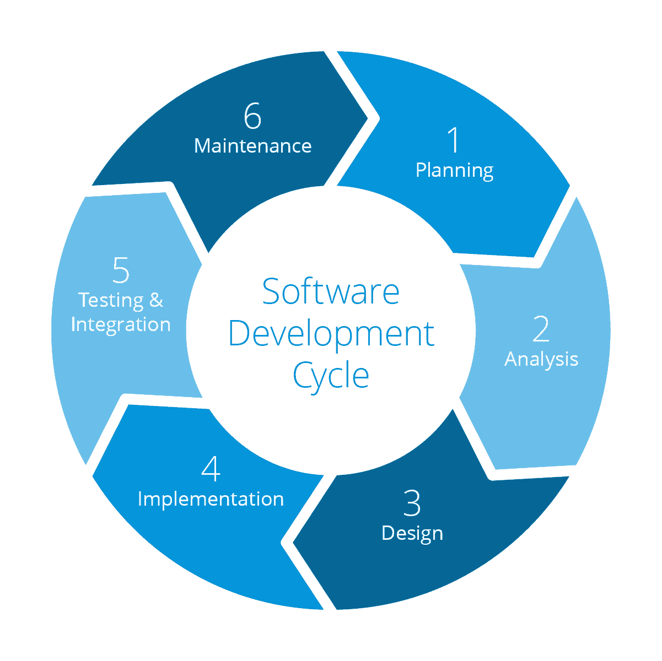
Requirement gathering
Testing and bug Fixing
Technology stack selection
Code implementation and development
UML artifacts design

Slide 16
UML Diagrams

Slide 17

Tech Stack
Notes:
Time – 2 mins

Slide 18








Backend
Data
Tools
Core Language
SQL Database
Version Control
Framework
Documentation
API Tester
Application Server
Notes:
Time – 1 min

Slide 19

Development
Notes:
Time – 1 min

Slide 20
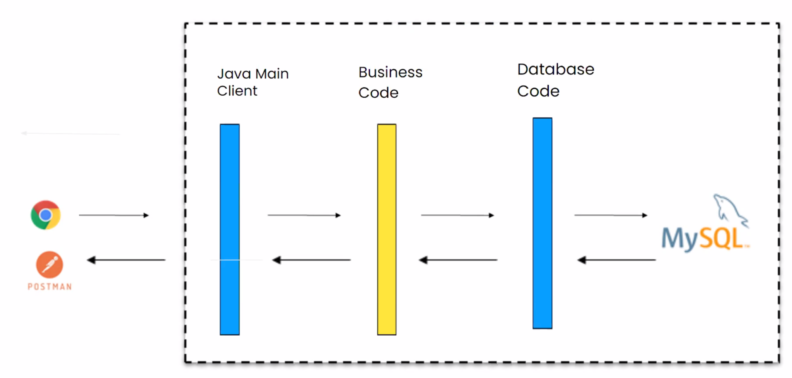
System Architecture

Slide 21

Challenges
Designing the UML diagrams using its conventions.
Installation of softwares on multiple environments.
Collaboration issues like merging code
Installing the Tomcat server and running application on it.
Notes:
Time – 2 mins
Challenges-
Installing the Tomcat server and running application on it.
Designing the UML diagrams using its conventions.
Learnings-
Got to learn new technologies.
Learnt working together in teams.(collaboration)
Learnt how to write code which is accepted by the industry.
Learnt how to make UML diagrams for the given problem.

Slide 22

Learnings
Got to learn new technologies.
Learnt how to write code which is accepted by the industry.
Learnt how to make UML diagrams for the given problem.
Learnt working together in teams.(collaboration)
Notes:
Time – 2 mins
Challenges-
Installing the Tomcat server and running application on it.
Designing the UML diagrams using its conventions.
Learnings-
Got to learn new technologies.
Learnt working together in teams.(collaboration)
Learnt how to write code which is accepted by the industry.
Learnt how to make UML diagrams for the given problem.

Slide 23

Future Scope
API Security- Auth token and decryption
Password encryption- Data security
Better notification system- inclusion of Google Firebase API
Payment gateways- inclusion of UPI, netbanking functionalities
UI for the webapp

Slide 24

Demo
Notes:
Time –
POS- Student -5 min
REST - Professor - 3 min
DropWizard- 3 min

Slide 25

Questions
Notes:
Time - ?

Slide 26
Thank you
Notes:
Time – After this show the testimonial video. 1 min

